Slide 1
COVID-19 ANALYSIS
STEPS & WORKFLOW
PRESENTED BY: Seif El-Rabbat
DELIVERED TO: ENG. Amr Saleh
ENG. Ahmed Reda
Eng. Mariam

Slide 2
Exploring main parts of the project process
EXPLORE
SOLVE
VISUALIZE
Explore Business and Technical recuirments
Solve complex technical problems as code problems and
OS comptabilty issues
Visualize data and tackle the business requirements to be presented to Global
Organizations.

Slide 3
A TIMELINE FOR STEPS COVERED
STEP 1
STEP 3
STEP 2
STEP 4
Technical Insights
Making Visualizations
Business Insights
Business Insights
Problems & how to solve them

Slide 4

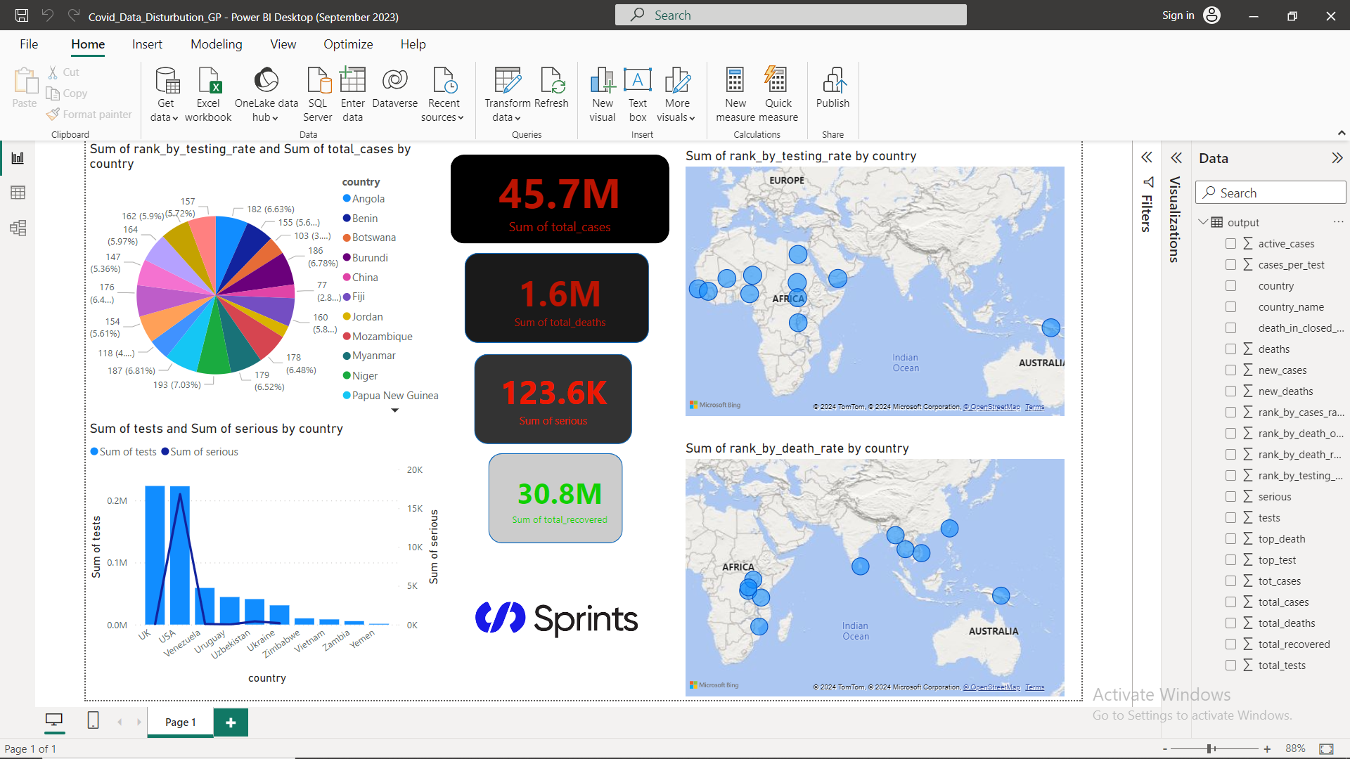
Business Insights
Designing a comprehensive
dashboard with pie and
geodemographic plots
to state useful insights
as what is the highest
country in Testing Rate

Slide 5
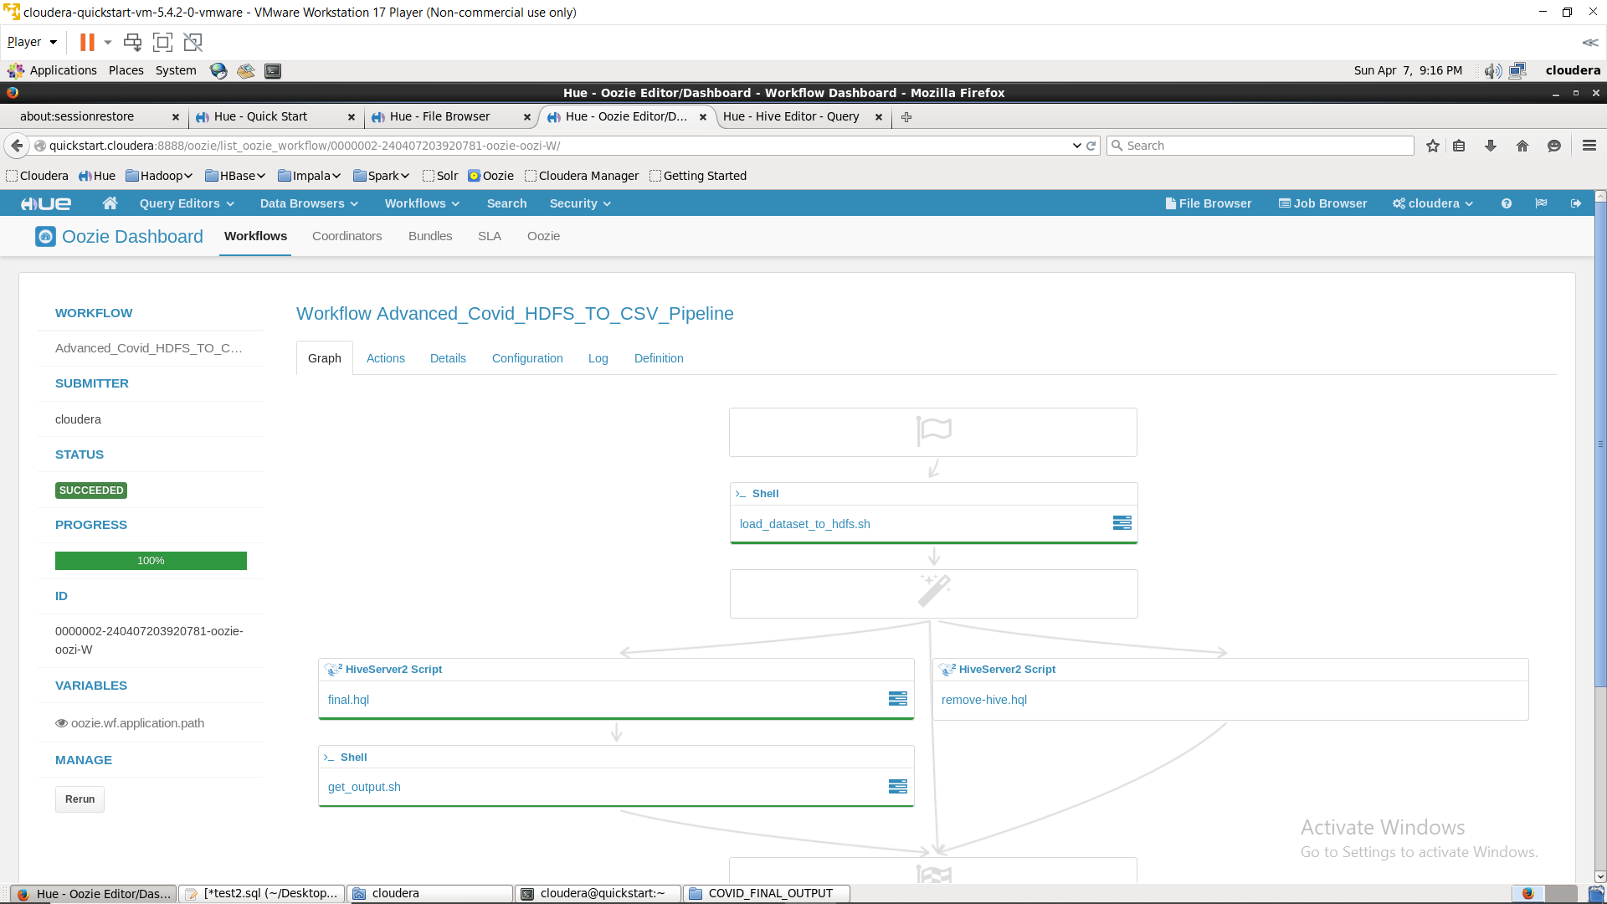
Business Insights
Implenting an automated
pipeline workflow
from ingestion till
visualization for
COVID dataset

Slide 6
Technical Insights
Extract
Extract data from covid-19 csv file.
Load
Load the data extracted to make the Staging, Partitioning, Final_Output stages.
Transform
Transform the data using HQL and hive commands to create tables for each stage with their characteristics.
Automate
Automate these ETL process to be used for any desired csv file.

Slide 7
01
02
03
Cloudera VM
Data Replication
Permission Denied
Problems & how to solve them
Cloudera’s 2.1 and lower versions comptavilty issues
After many excutions for hql script you might want to delete the created tables
to avoid row replicas
While running a shell script you might face some permissions error
Update VM to 5.4.2.0 or any higher versions
(recommended)
Delete COVID_HDFS_LZ,
COVID_HDFS_LZ_Partioned
and Final_Output folders then rerun script
Use SUDO chmod 777 (Folder_Path) or
Any relevant script

Slide 8

ALL THESE INFECTED CASES ARE NOT JUST NUMBERS
THANKS!
GitHub: https://github.com/Seif-R15/Covid_Analysis/

